Slide 1
What is a Survey Paper??
CSE594 Fall 2009
Jennifer Wong
Oct. 14, 2009

Slide 2
A survey paper is…
"a paper that summarizes and organizes recent research results in a novel way that integrates and adds understanding to work in the field. A survey article assumes a general knowledge of the area; it emphasizes the classification of the existing literature, developing a perspective on the area, and evaluating trends."
As described by ACM Computing Surveys

Slide 3
Goals of a Survey
Provide reader with a view of existing work that is well organized and comprehensive
  Not all details must be included, which one’s should/shouldn’t?
  Make sure to cover all relevant material completely
  Logical structure of organization
  State-of-the-art view

Slide 4
Your survey paper should …
Summarize the research in 5-8 papers on a particular topic
Include your own commentary on the significance of the approach and the solutions presented in each paper
Provide a critical assessment of the work that has been done
Include a discussion on future research directions
REMEMBER
  Everything you write in this survey paper has to be in your own words
  All ideas, paraphrases of other people's words must be correctly attributed in the body of the paper and in the references
  Any evidence of it in the survey paper will result in a fail grade

Slide 5
How To Find Articles
Search various digital libraries
  ACM
  IEEE
  Google Scholar
Try to identify research groups/faculty in the area
  Dig into their work and pointers

Slide 6
How To Pick Articles – In General
When picking papers to read - try to:
  Pick a recent survey of the field so you can quickly gain an overview,
  Pick a paper that you can easier understand – book chapters often give easier understandable materials and lengthy explanation that may give you a head start, although they may not be as up-to-date as papers,
  Pick papers that are related to each other in some ways and/or that are in the same field so that you can write a meaningful survey out of them,
  Favour papers from well-known journals and conferences,
  Favour “first” or “foundational” papers in the field (as indicated in other people’s survey paper),
  Favour more recent papers,
  Once you have identified an interesting technology to report upon, follow developments in that strand of technology (e.g. time-wise and technology-wise developments).
  Find relationships with respect to each other and to your topic area (classification scheme/categorization)

Slide 7
Article Structure
It should not be just a concatenation of paper reviews
A typical structure of a paper includes:
  Title
  Abstract
  Introduction
  Body of paper
  Conclusion/Future Work
  References

Slide 8
Article Structure
Introduction
  Importance and significance of the topic
  Discuss the background and target audience
  Summarize the surveyed research area and explain why the surveyed area has been studied
  Summarize the classification scheme you used to do the survey
  Summarize the surveyed techniques with the above classification scheme

Slide 9
Article Structure
Survey details/Body of paper
  Present the surveyed techniques using the classification scheme in detail
  Identify the trends in the surveyed area. Give evidences for your decision
  Identify some leading research/products/companies/web-sites
  Identify the unresolved problems/difficulties, and future research issues

Slide 10
Article Structure
Conclusions/Future work
  Summarize the conclusions of your survey
References
  List all the citations referenced in your paper

Slide 11
Figures
Can be taken from papers as long as appropriate credit is given
  “Figure taken from [28]”.
Draw your own figures to show classification or structure of the survey
Use tables to organize comparisons between applications/systems/etc

Slide 12
How to Cite a Reference
Cite the full info about the paper
  Author names
  Paper title
  Publication details
  Page numbers
  Year, etc
In the text, use "[1]" to refer
[1] Adomavicius G, Tuzhilin A., “Toward the Next Generation of
Recommender Systems: A Survey of the State-of-the-Art and Possible
Extensions”, IEEE Transactions on Knowledge and Data Engineering,
Vol. 17, No. 6. (June 2005), pp. 734-749.
There are many bibliography formats. Select one and stick to it.
http://standards.ieee.org/guides/style/2009_Style_Manual.pdf (Chap 19)
http://sgs.umkc.edu/pdfs/ACM-STYLE-EXAMPLES.pdf

Slide 13
General Rules for Bibliography
Avoid use of et al. in a bibliography unless list is very long (five or more authors).
Internet drafts must be marked ``work in progress''.
Book citations include publication years, but no ISBN number.
It is now acceptable to include URLs to material, but it is probably bad form to include a URL pointing to the author's web page for papers published in IEEE and ACM publications, given the copyright situation. Use it for software and other non-library material. Avoid long URLs; it may be sufficient to point to the general page and let the reader find the material. General URLs are also less likely to change.
Leave a space between first names and last name, i.e., "J. P. Doe", not "J.P.Doe".

Slide 14
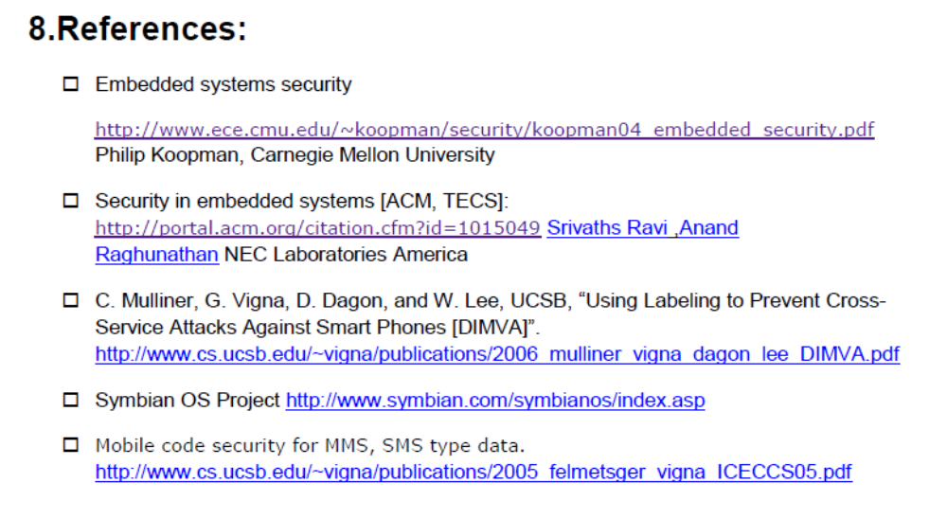
What not to do….

Slide 15
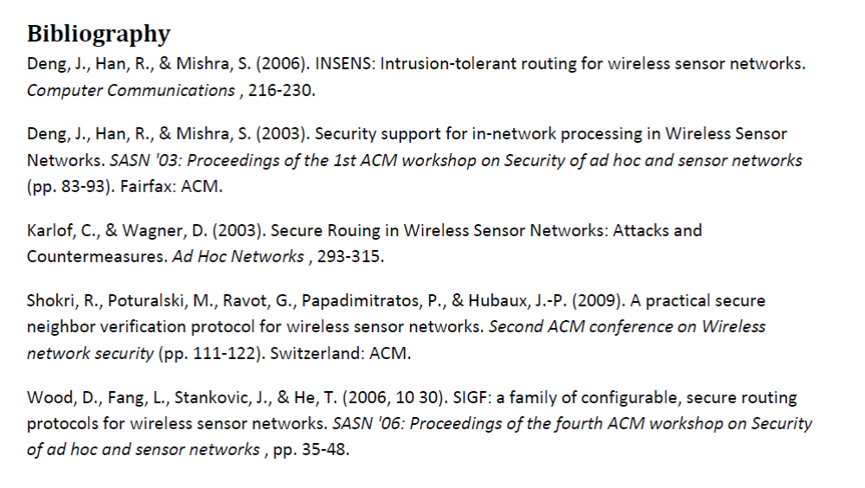
What not to do….

Slide 16
